Slide 1
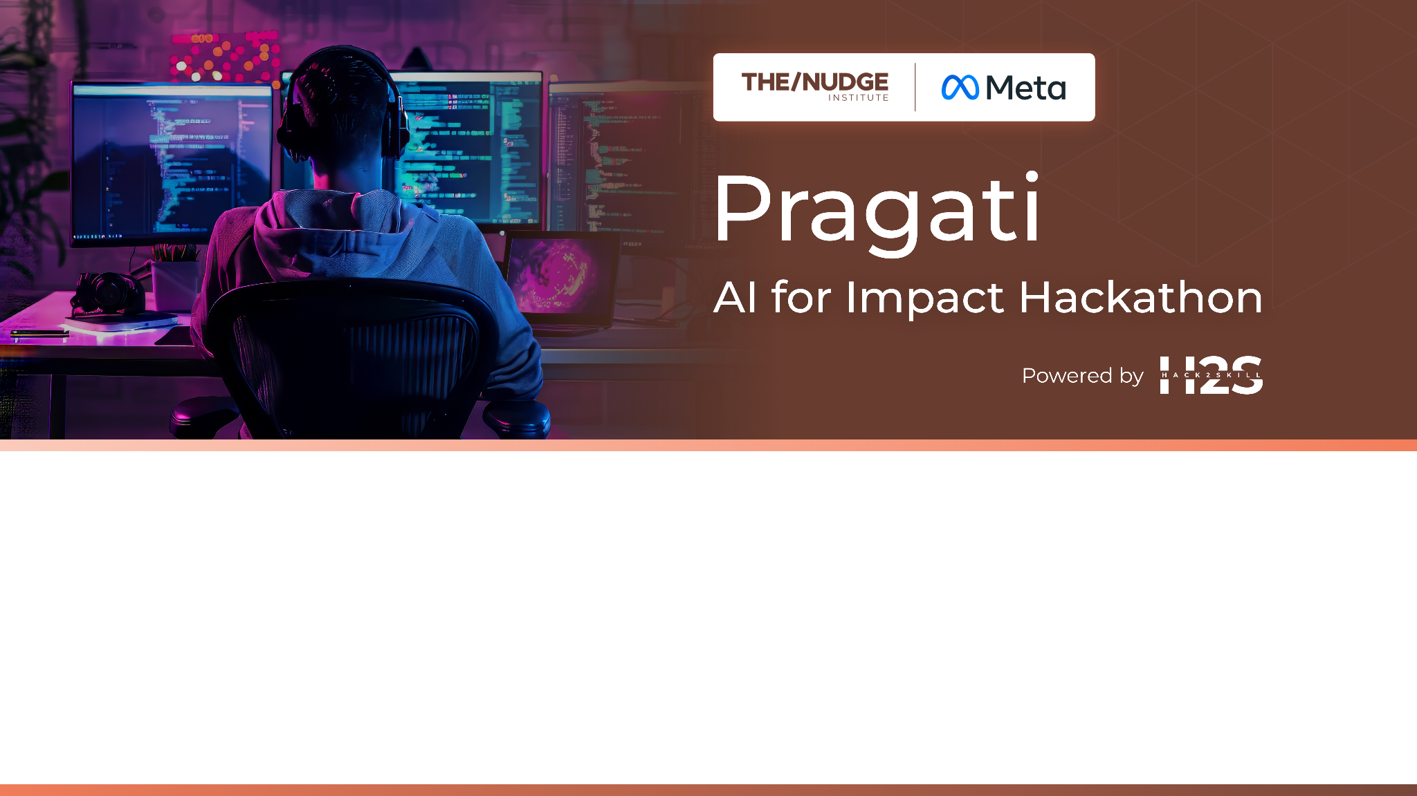
Team Name : 404
Team Leader Name : Chaitanya Patange
Which domain does your idea address?: Skilling

Slide 2


What is the problem you are solving? (50 words max)
We are solving the problem of inaccessible and inefficient job matching and skill development by providing an AI-powered platform that helps users—regardless of internet access—identify suitable jobs, analyze skill gaps, and receive personalized learning and certification to improve their employability.

Slide 3

Describe your solution. How different is it from any of the other existing ideas? How will it be able to solve the problem? USP of the proposed solution? What is the intended impact of your solution (max 350 words).
Our solution is an inclusive, AI-powered platform that helps users find their desired jobs, identify skill gaps, and upskill through personalized crash courses and certification. It is accessible via a website, mobile app, and even voice/ SMS—ensuring that users with little or no internet access can still be benefited.
How It Works:
The user uploads their resume and desired job description through the app, website, or SMS/MMS.
Our AI analyzes the resume and extracts both technical and soft skills.
It compares the user’s profile with current job market requirements or their dream job based on the Job Description, then:
Suggests relevant job opportunities
Identifies skills the user already has
Highlights skill gaps that need to be filled
The mobile app supports both online and offline use. Users can download an offline AI model to analyze resumes which runs without internet connectivity.

Slide 4
For the skills required by the company, users are guided to a second platform that offers:
AI-generated crash courses tailored to their specific needs
An AI-generated exam at the end of each course
A certificate of completion, boosting their resume and job prospects
How It’s Different:
Unlike most job platforms that require internet access and only suggest jobs, our platform:
Works even offline or via SMS/voice
Uses AI to personalize upskilling content and certification
Offers end-to-end support: from identifying gaps to filling them
USP (Unique Selling Proposition):
Accessibility-first: Works for people with limited internet or digital literacy
AI personalization: Tailored courses and exams, not one-size-fits-all
Low-bandwidth design: Ideal for remote and rural areas
Intended Impact: Our goal is to enable job access and skill development through a smart, low-bandwidth, and personalized platform—helping users to achieve their dream jobs.

Slide 5

Who is the primary user of your solution, and explain how your solution will leverage open-source AI to address the aspects mentioned in the Key Design Guidelines (max 200 words).
Primary User:
Our solution targets job seekers who often face barriers like limited internet access, basic devices, low digital literacy, and economic constraints. Many are first-time tech users or rely on shared or feature phones.
How We Leverage Open-Source AI:
We use lightweight open-source AI models (e.g., ONNX, TFLite) for offline resume parsing and skill gap analysis on low-end mobile devices, ensuring connectivity resilience. AI-generated personalized crash courses and assessments are hosted online in regional languages, addressing language and trust issues.
To tackle resource limitations, we use open AI Modals and community-contributed content to generate learning material. Our voice/ SMS interface extends AI access to users without smartphones or internet, ensuring technical inclusivity.

Slide 6
Key Design Guidelines
Technical Realities
Connectivity: Only ~1MB of data needed to upload resume or skills info.
Devices:
Smartphones: Mobile Application (Android/ IOS)
Feature Phones: Call/SMS support with no internet needed.
Laptops and Desktops: can use the Website.
Power Reliability:
Lightweight: Lightweight Applications can run easily on Mobile.
Cloud Service: Can be Hosted on the cloud for 24/7 availability.
Ethical Consideration
Data Privacy and Security: Only essential data is processed; nothing is stored, and the app uses offline models.
Transparency: AI results are clearly explained in simple language.
Bias Mitigation: Ignores gender, region, and background to ensure fair recommendations.
Sustainability: Open-source, low-cost, and built for long-term community use.
User Context
Digital literacy: Minimum requirement is to know how to send an SMS/ Voice call
Language: Basic english to initiate chat and regional language knowledge
Trust: Only skills are processed—no data is stored; analysis is done via Meta AI.
Resource Limitations
Economic: Since its mostly AI generated work it can be charged negligibly or can use offline model.
Data: Leveraging open AI models removes our dependencies on datasets.
Expertise: The platform requires low maintenance and designed for community-based deployment.

Slide 7
How is this solution scalable? (100 words max)
Our solution is highly scalable due to its :
Uses open-source AI models, reducing licensing costs and enabling customization.
Modular microservices allow independent updates, deployment, and scaling.
Offline mobile AI reduces backend dependency, enabling usage at scale even in remote areas.
SMS and voice access work on feature phones, scaling reach in low-connectivity regions.
Lightweight data usage (~1MB per resume) ensures efficiency over slow networks.
Supports regional language integration for localized deployment.
Lightweight Models can be used for faster inference and lower resource usage.
APIs are stateless, making it easier to distribute load across servers.
Can integrate with job boards and government employment portals via APIs.
Designed to be deployed in multiple regions with minimal changes.
Open-source nature encourages contributions and local community adaptations.
Certificate generation and crash course content are dynamically AI-generated, allowing infinite scaling without manual input.

Slide 8
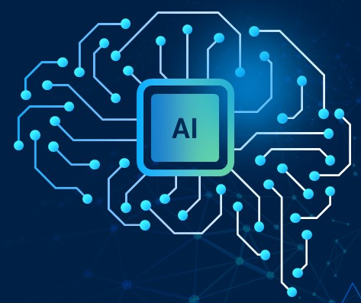








List of features offered by the solution
It is always better to add a few visual representations (drawings/sketches/illustrations etc.) to your presentation, it adds to the power through which it reaches the audience.
📝
Uploads Resume
AI Course Website
Skill Analyser
Artificial Intelligence
Laptop
Predict Jobs
Learn a Course
Website
Llama3
Llama3
Get his Dream Job
Application
Suggests Courses
Take a Test
Call/ SMS
Shows Skill Gaps
User
Smart Phone
Earn Certificate
Uploads
Job Description
✏️
Feature Phone

Slide 9

What open-source AI tools and technologies will you use to design the solution? (Please list all.)
Resume Parsing: pdfplumber library from Python
Job Matching & Market Trend Analysis: Llama-3.3-70B-Instruct by Meta
AI-Generated Courses & Exams: Llama-3.3-70B-Instruct by Meta
Mobile Offline AI: Llama 3.2: 1B & 3B (Lightweight)
Voice/SMS Integration: Twilio
Frontend & Backend Stack: React Native, Flask

Slide 10
Why are these open-source technologies the most appropriate for your solution? (150 words max)
These open-source technologies are ideal for our solution because they offer flexibility, scalability, and cost-efficiency—key for building an accessible platform.
pdfplumber enable fast, accurate resume parsing and skill extraction with minimal training.
ONNX Runtime and TensorFlow Lite allow us to deploy lightweight AI models on mobile devices, supporting offline functionality crucial for low-connectivity users.
Llama-3.3-70B-Instruct by Meta help generate personalized courses and exams dynamically.
Twilio support inclusive communication via SMS and voice, reaching users without smartphones.
React Native enables us to reach more audience with just a single codebase #cross platform.
Flask gives a one stop solution to integrate AI with backend.
These tools are well-documented, community-supported, and modular, making integration and scaling easier. Together, they form a powerful, cost-effective, and adaptable tech stack.

Slide 11

Describe the Solutions Architecture (500 words)
Our platform is designed with a modular, scalable, and inclusive architecture to support job seekers across different connectivity levels. The system consists of three core interfaces—Web App, Mobile App, and Voice/ SMS System—which connect to a backend powered by open-source AI models and microservices. Here's how it all fits together:
1. Web Application
Built using React Native (Frontend) for cross-platform support Python (Backend)
Allows users to upload resumes and specify desired job roles
Displays job suggestions, skill gap analysis, and personalized course dashboard
2. Mobile Application
Built using React Native for cross-platform support
Supports both online and offline modes
Offline Mode: Uses ONNX/ TensorFlow Lite to load the models which is used to analyze resumes locally
Online Mode: Syncs with backend APIs for real-time recommendations and course updates
3. Voice/SMS System
Users can:
Call a number and speak their skills/job interests (handled via Speech to text engine)
Send SMS/MMS with text or resume
Twilio handles call routing, transcription, and SMS
Parsed inputs are sent to backend for processing

Slide 12
4. Analysing Resume using AI
Uses pdfplumber to extract data from the Resume.
Which is then given to AI model to extract Technical skills, Soft skills, Work experience and Education.
5. Skill Gap Analyzer & Job Finder: Uses Llama model by Meta to compare the skills and job description and find skill gaps along with relevant jobs.
6. Course & Exam Generator
Uses AI model by Meta to:
Generate personalised crash courses (content, quizzes)
Create a tailored AI-generated exam at the end
Generates certificates based on their certification course test result.
Conclusion
This architecture ensures high scalability, accessibility, and personalization. Whether a user is online, offline, or using SMS/voice, they can seamlessly access AI-driven job recommendations, upskill, and earn credentials—all from a single integrated ecosystem.

Slide 13
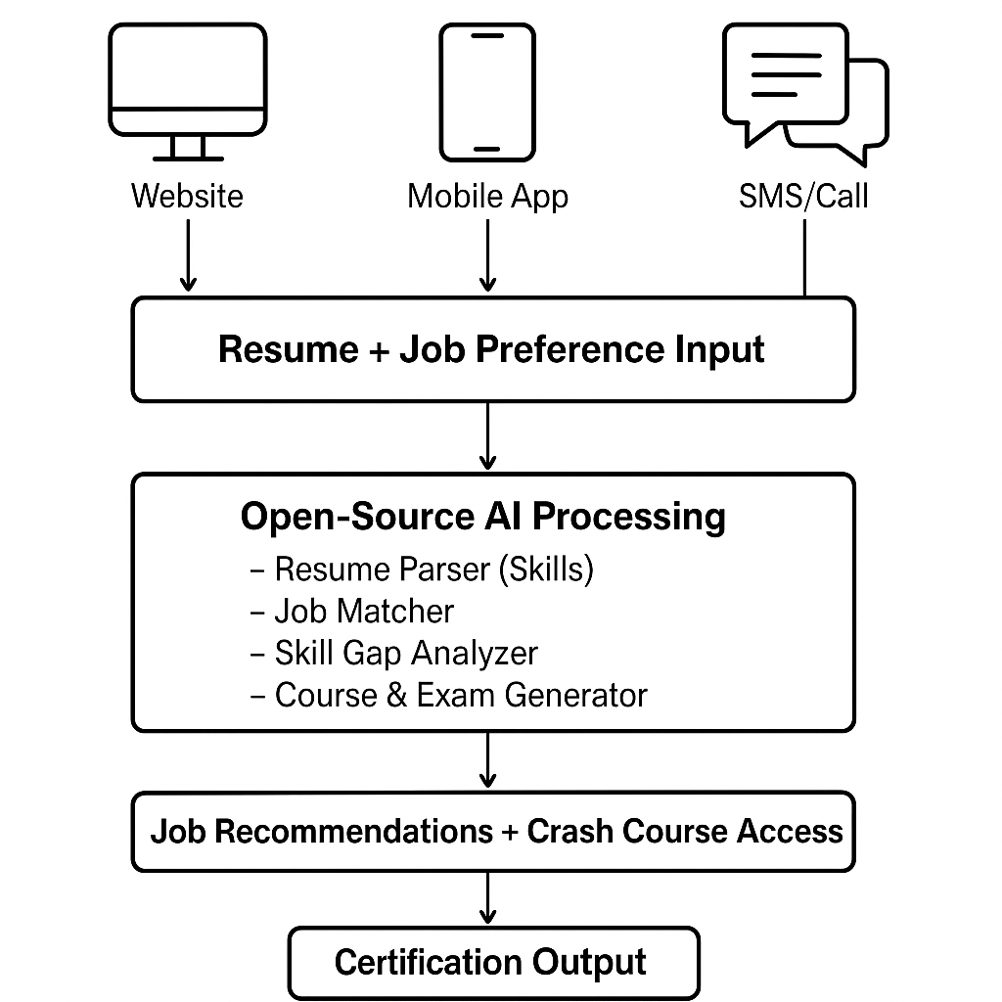




Provide a high-level architecture diagram or a use-case diagram of your proposed solution

Slide 14
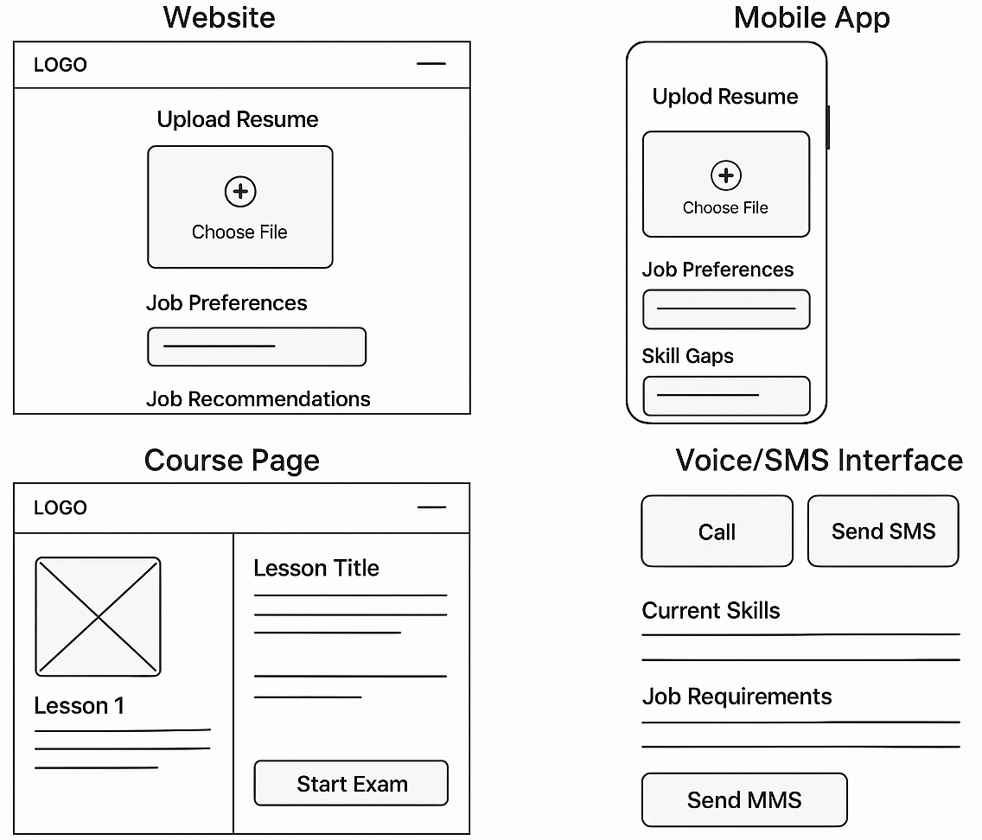


Please share the wireframes/Mock diagrams of the proposed solution (optional)

Slide 15
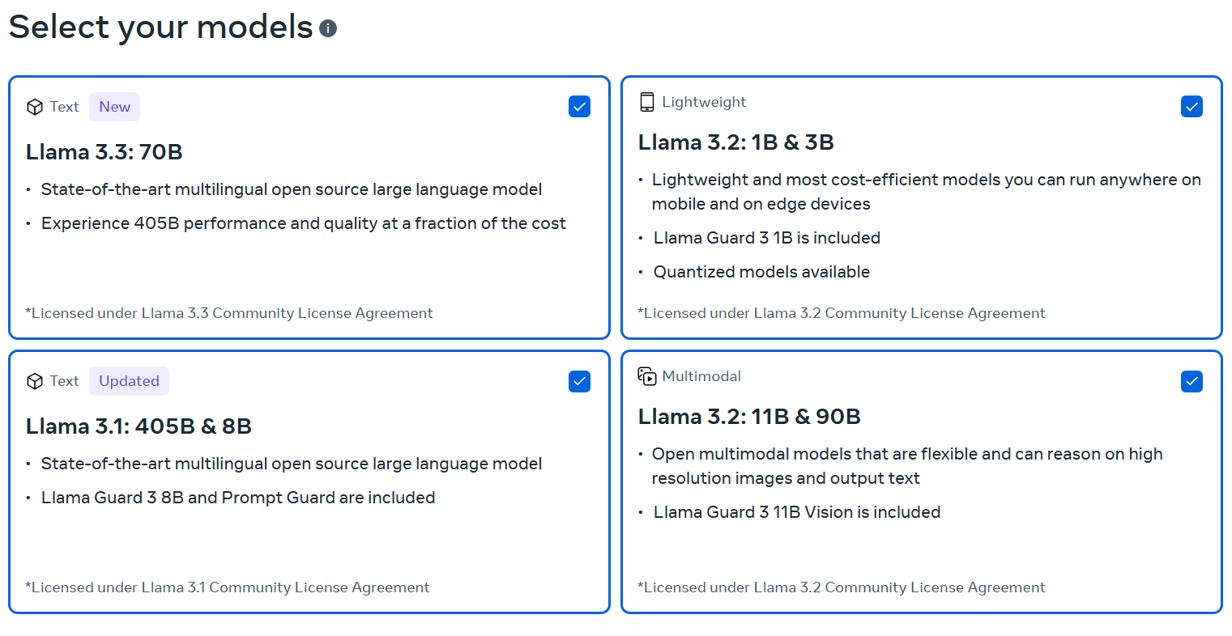

What datasets will your solution use? Are they publicly available, synthetic, or user-generated?
Using Llama AI Models
No ML datasets are being used.*

Slide 16




Does your solution require cloud-based computation, or can it work with on-device processing? If cloud-based, how do you plan to address connectivity challenges and cost constraints?
Cloud-based computation may be used to host the website, but it is not essential and will not be utilized during the development phases.
We also provide SMS/Voice call feature which solves the connectivity challenges.

Slide 17
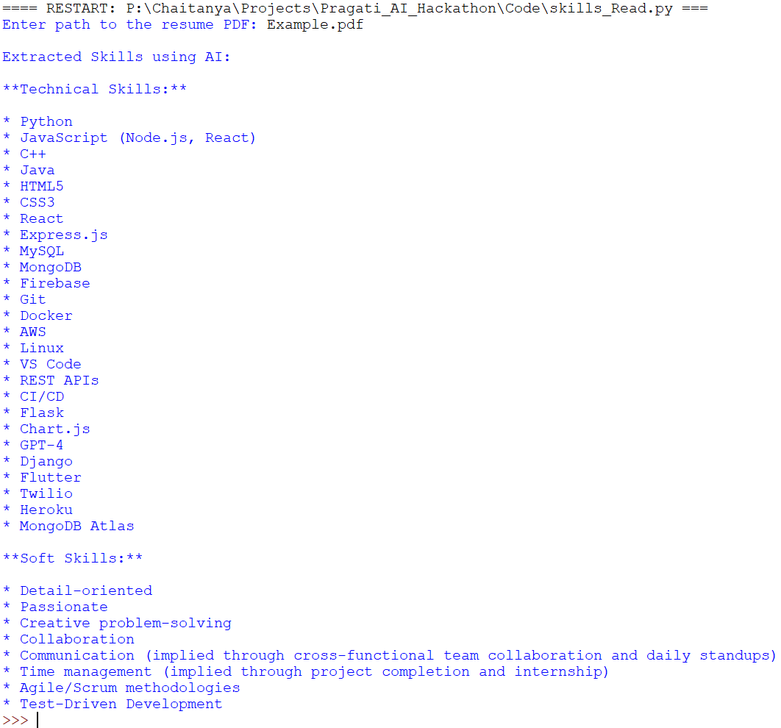
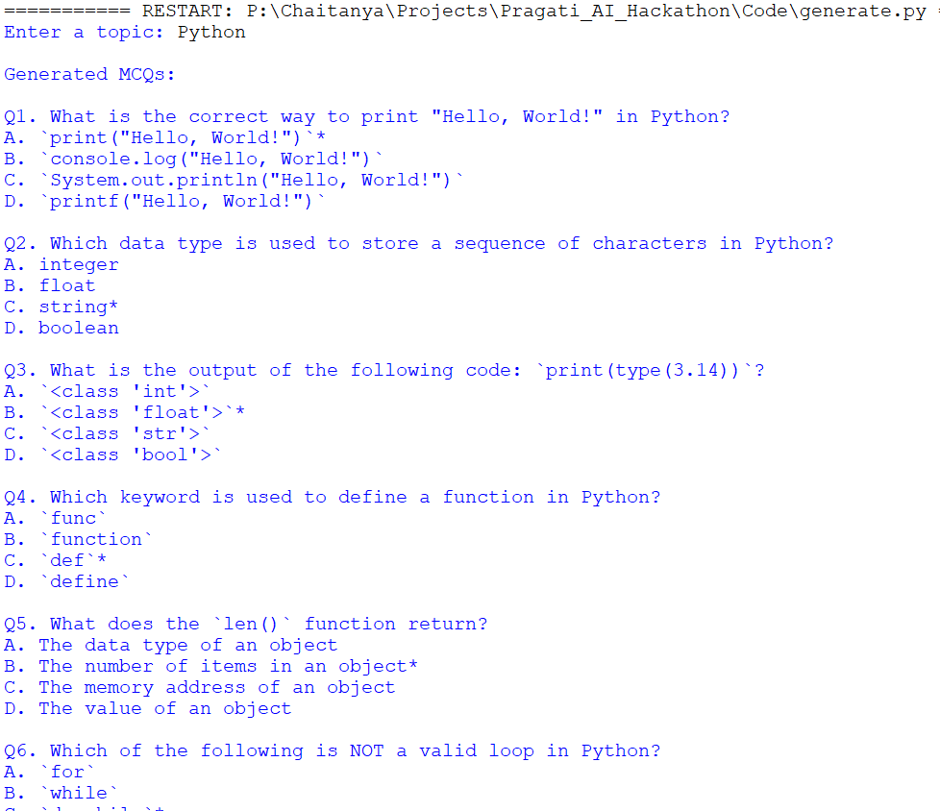
Progress
Extracting Skills from Resume Using AI |
Generating Questions for Course Exam using AI
(Correct answer Marked with *)

Slide 18
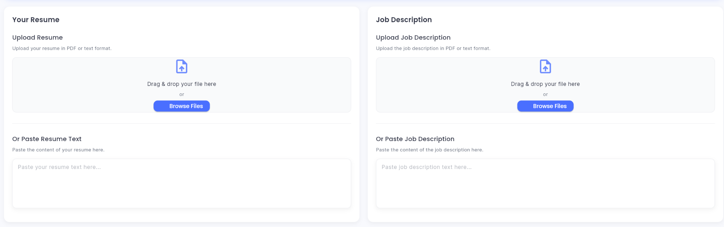
Resume Upload, Job Description Website Prototype

Slide 19
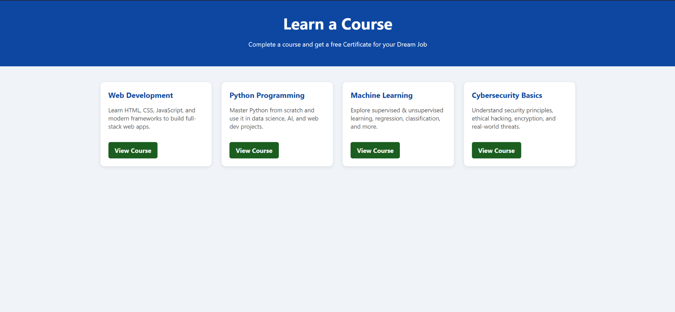
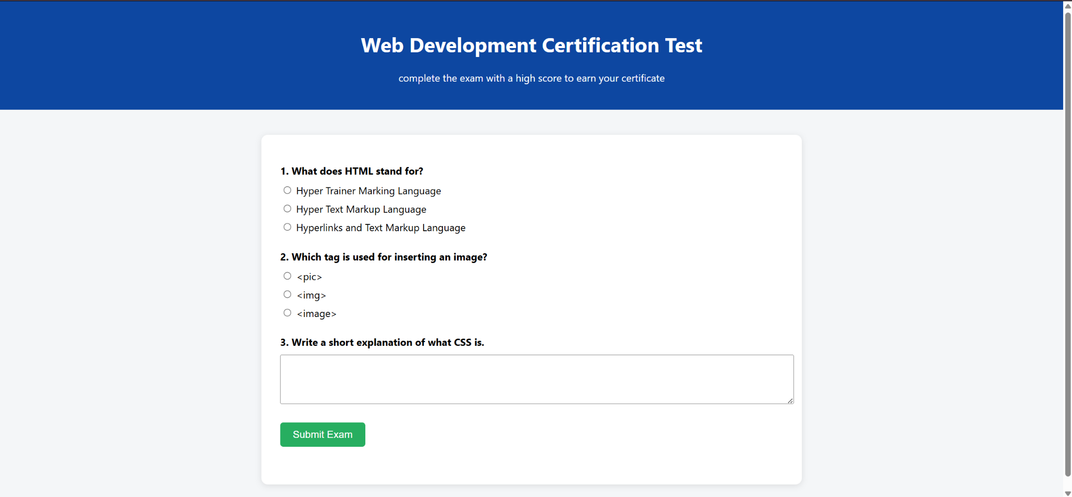
Course Website Prototype
Certification Test
Website Prototype

Slide 20
